Slide 1


Employee Profile
Wireframes v. 2

Slide 2
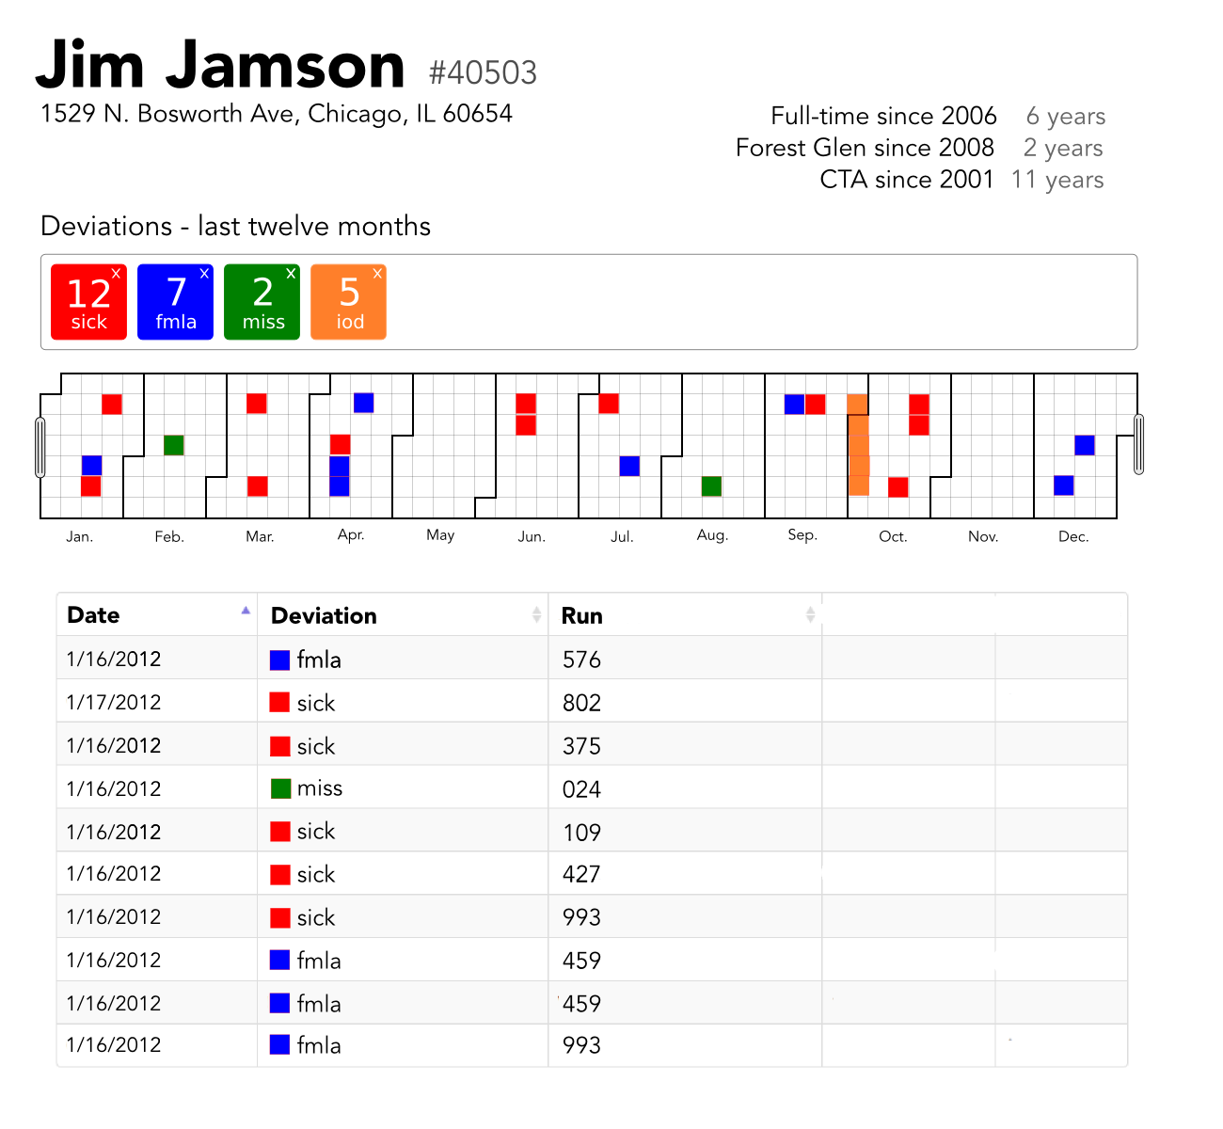

Slide 3
